Slide 1
The Plain Language Adaptation of Biomedical Abstracts (PLABA) track @ TREC
Brian Ondov, PhD
Department of Biomedical Informatics & Data Science

Slide 2
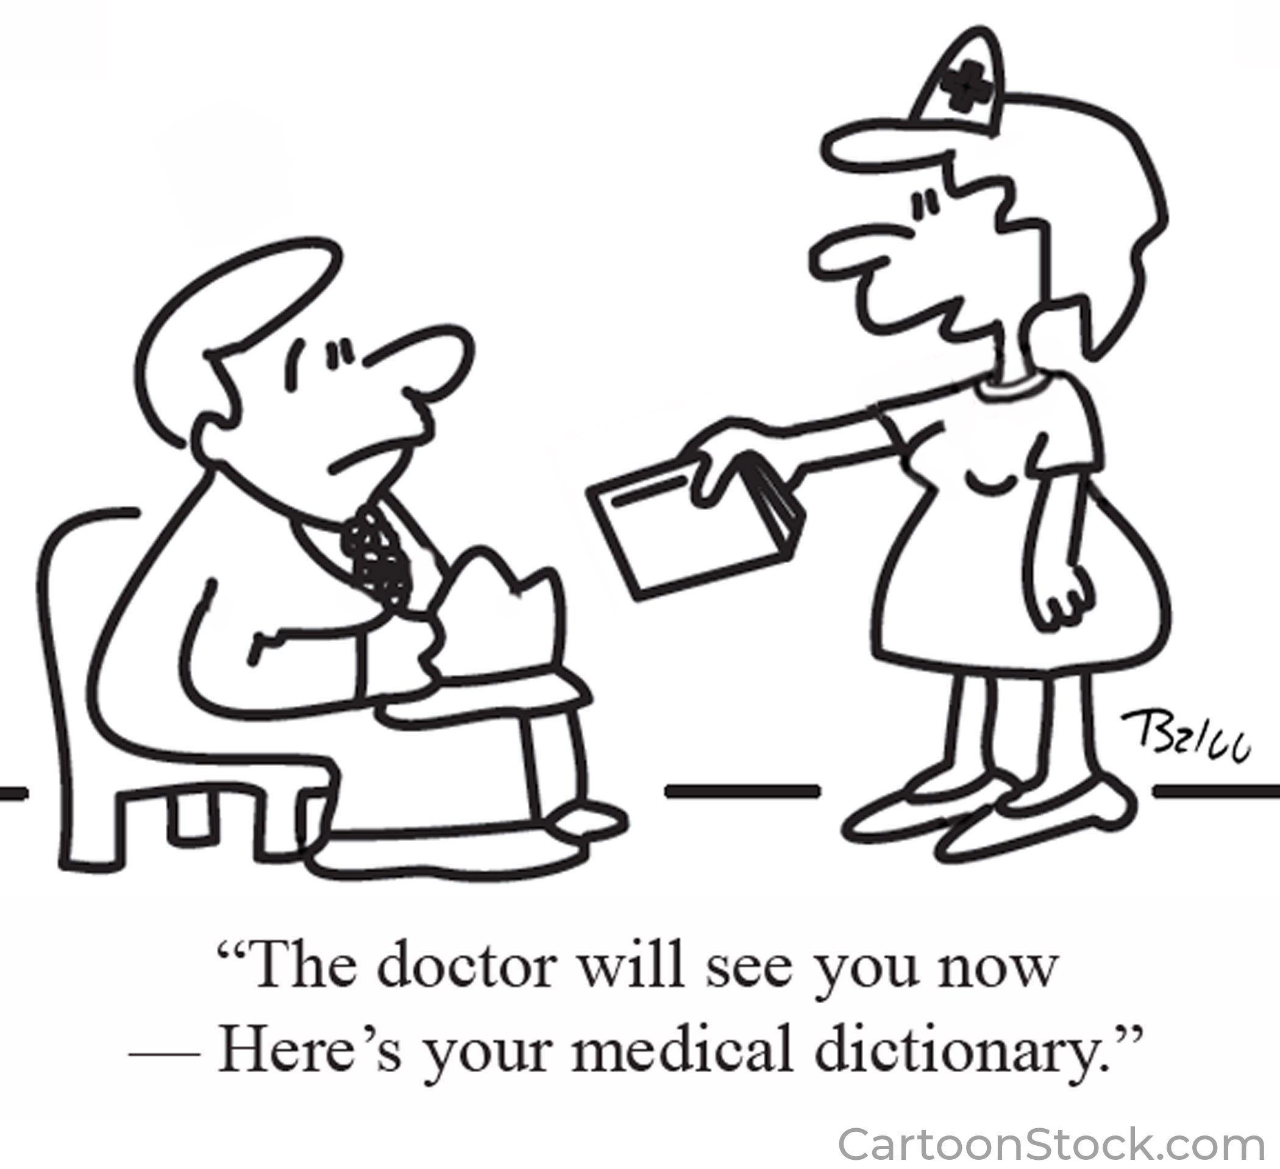
Outline
Why Rewrite Abstracts?
Creating a High-quality Dataset
Sentence-level Evaluation
Baselines and Team Systems
Manual and Automatic Results
Assessing Automatic Metrics
New Subtask: Term Replacement

Slide 3
1. Why Rewrite Abstracts?

Slide 4
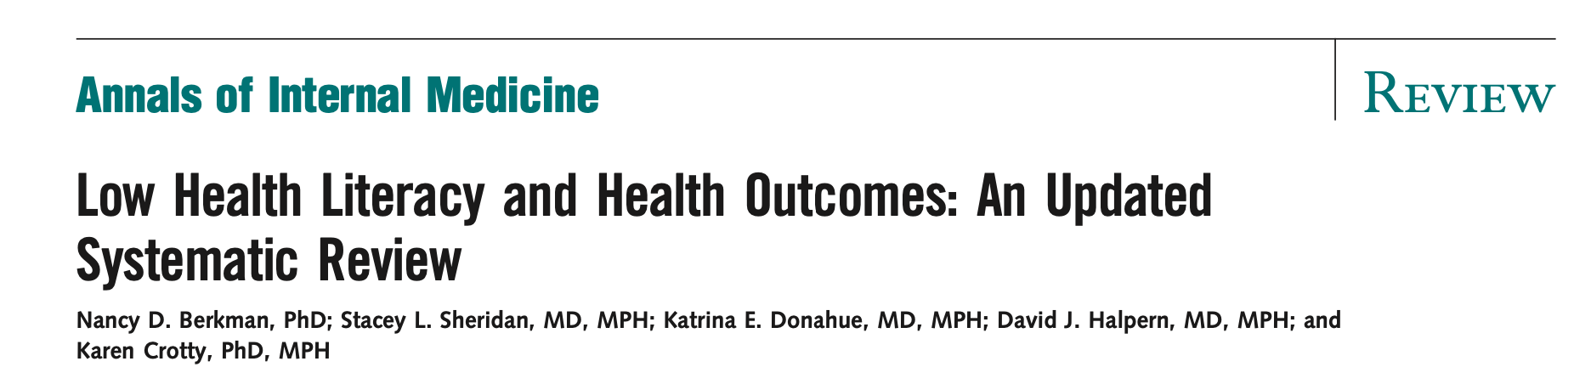

Health Literacy

Slide 5
“Cyberchondria”
“…escalation is associated with the amount and distribution of medical content viewed by users, the presence of escalatory terminology in pages visited, and a user's predisposition to escalate versus to seek more reasonable explanations for ailments…”
White RW, Horvitz E. Cyberchondria: studies of the escalation of medical concerns in web search. ACM Transactions on Information Systems (TOIS). 2009 Nov 30;27(4):1-37.

Slide 6
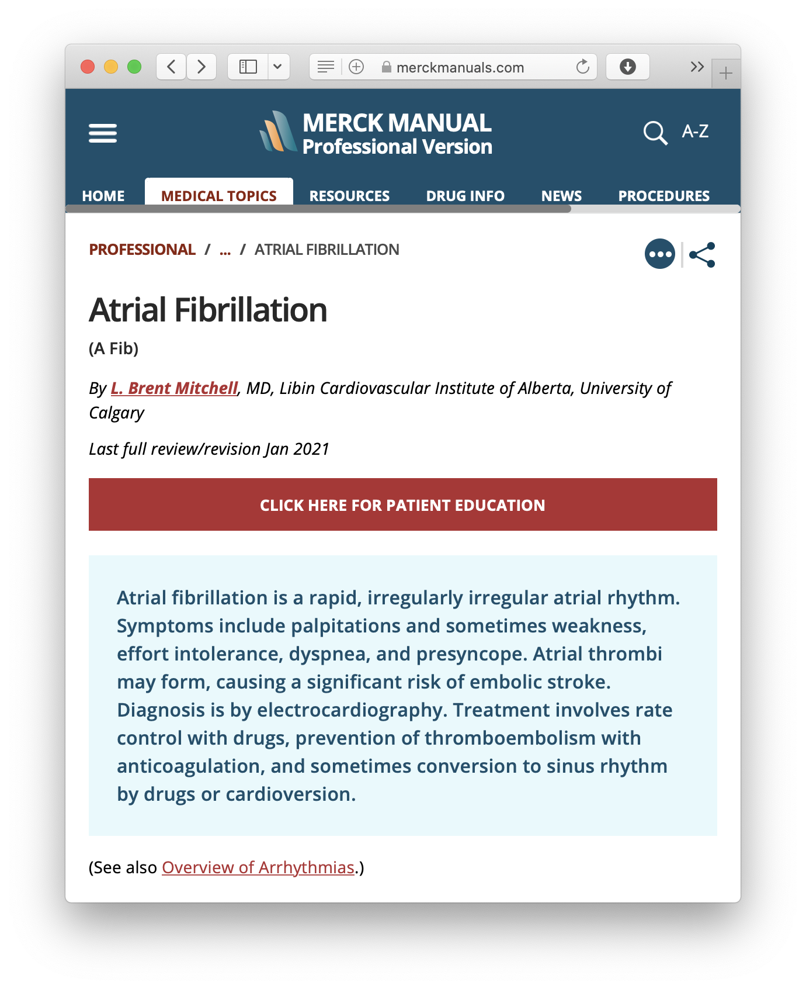
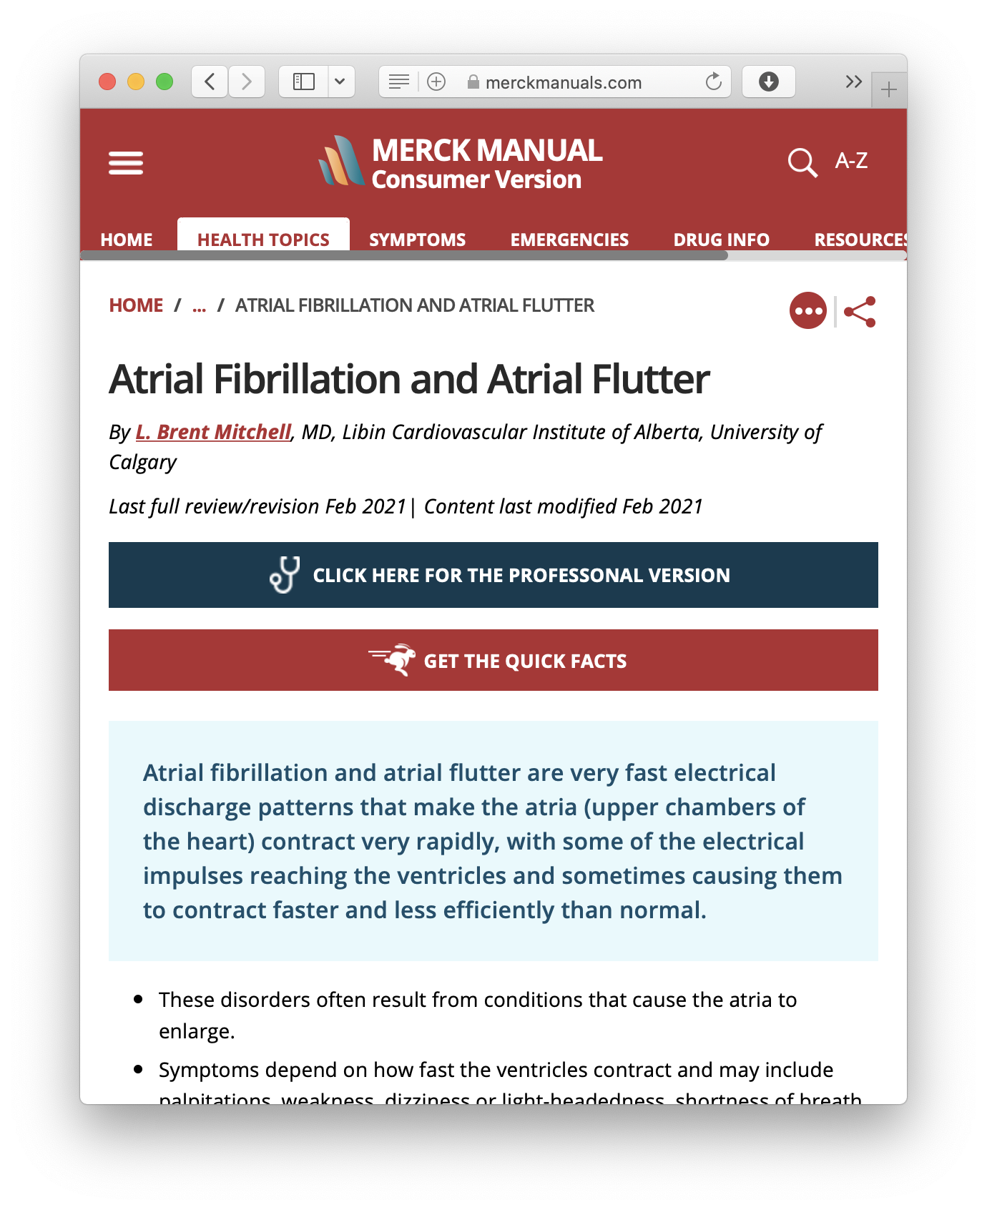

Slide 7

PMID 17011955
…at 1 day, 2 months, and last follow-up examination…visual recovery after retinal reattachment was most dependent on macular involvement…
How long will it take to achieve good vision after retina detachment surgery?
PMID 26943151
…evaluate best-corrected VA (BCVA) at 1, 2, 3, 6, 9, and 12 months after vitrectomy…best-corrected visual acuity significantly improved over time (P < 0.001), and the improvement correlated with EZ-RPE thickness (r = -0.45, P = 0.021)…
PMID 33974368
…the mean CDVA (logMAR) improved significantly from 1.35 ± 1.38 to 0.29 ± 0.37 at 6 weeks and remained stable at 12 months postoperatively in monofocal eyes (P = .001) and from 1.16 ± 1.2 to 0.37 ± 0.29 (6 weeks) and 0.20 ± 0.36 (12 months) in mIOL eyes (P = .001)…

Slide 8
Overcoming the Language Barrier
PMID 26943151
…evaluate best-corrected VA (BCVA) at 1, 2, 3, 6, 9, and 12 months after vitrectomy…best-corrected visual acuity significantly improved over time (P < 0.001), and the improvement correlated with EZ-RPE thickness (r = -0.45, P = 0.021)…
…used standard eyesight charts to measure vision clarity (with glasses or contacts if needed) at 1, 2, 3, 6, 9, and 12 months…vision improved over time, and the improvement corresponded with thickness of a particular layer of the retina called the ellipsoid zone-retinal pigment epithelium (EZ-RPE)…

Slide 9
Source (PMID 34362836)
Background: Little population-based data exist about adults with primary nephrotic syndrome.
Nephrologists reviewed medical records for clinical presentation, laboratory findings, and biopsy results to confirm primary nephrotic syndrome and assigned etiology.
We identified a 1:100 time-matched cohort of adults without diabetes, diagnosed nephrotic syndrome, or proteinuria as controls to compare rates of ESKD, cardiovascular outcomes, and death through 2014, using multivariable Cox regression.

Slide 10
Removal of section headers
Background for first use of central term
Source (PMID 34362836)
Adaptation by human expert
Background: Little population-based data exist about adults with primary nephrotic syndrome.
Nephrologists reviewed medical records for clinical presentation, laboratory findings, and biopsy results to confirm primary nephrotic syndrome and assigned etiology.
We identified a 1:100 time-matched cohort of adults without diabetes, diagnosed nephrotic syndrome, or proteinuria as controls to compare rates of ESKD, cardiovascular outcomes, and death through 2014, using multivariable Cox regression.
Nephrotic Syndrome (NS) is a combination of symptoms relating to the kidneys. There is not much information about how NS exists in the population.
Kidney specialists looked at medical records to confirm NS and determined causes.
For comparison, we also found a group of adults with no diabetes, NS, or proteinuria (too much protein in the urine) through 2014. This group was to compare rates of kidney failure, heart disease, and death using statistical methods.
Consistent abbreviation
Consistent abbreviation
Consistent abbreviation
Replacement of jargon
Replacement of jargon
Generalization
Splitting of long sentences
Parenthetical explanation on first use

Slide 11
Plain Language Adaptation

Slide 12
2. Creating a High-quality Dataset

Slide 13
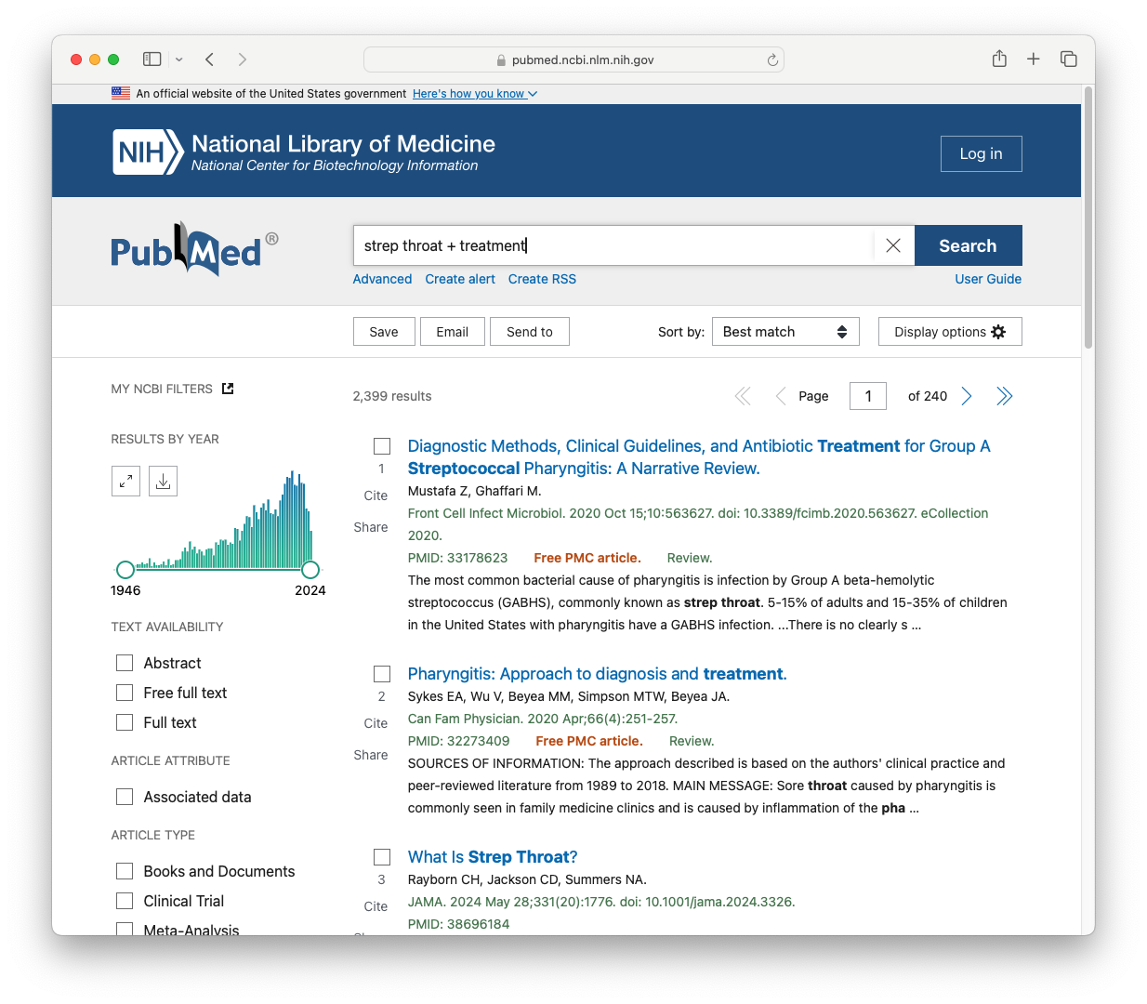
75
MedlinePlus
Questions
10
PubMed
results
750
abstracts
✍️
921
adaptations
X
=
Science writers
&
NLM Index Section
Ondov 2022

Slide 14

Annotator Guidelines
Replace professional jargon with common, consumer-friendly terms
Interphalangeal joint
Finger knuckle
Orthoses
Braces
Substitute longer, more arcane words for shorter, more common synonyms
Inhibits
Blocks
Evaluated
Tested

Slide 15
Annotator Guidelines
Splitting sentences: if a sentence is long and contains two or more complete thoughts, it should be split into multiple sentences that are simpler.
Treatment guidelines state that there is no difference in efficacy between the various first-generation antipsychotics, however, low-potency first-generation antipsychotic drugs are sometimes perceived as less efficacious than high-potency first-generation compounds by clinicians, and they also seem to differ in their side effects.
Treatment recommendations say there is no difference in how well older drugs used to treat psychotic disorders work. However, doctors sometimes think older drugs with higher doses do not work as well as those with lower doses. The higher-dose drugs also seem to have different side effects.

Slide 16
Annotator Guidelines
If the jargon or a named entity does not have plain synonyms, leave as is in the first mention but explain it with parentheses or nonrestrictive clauses
Duloxetine is a combined serotonin/norepinephrine reuptake inhibitor currently under clinical investigation for the treatment of women with stress urinary incontinence.
Duloxetine (a common antidepressant) blocks removal of serotonin/norepinephrine (chemical messengers) and is studied for treating women with bladder control loss from stress.
Subsequent mentions in the same abstract do not need to be explained

Slide 17
Annotator Guidelines
Change passive voice to active voice when possible
Results: eleven trials published between 1965 and 1999 including a total of 2081 participants fulfilled the inclusion criteria and were further analysed.
We looked at eleven studies published between 1965 and 1999 with a total of 2081 people.

Slide 18
Annotator Guidelines
If a subheading is followed by a complete sentence, omit
Perphenazine is an old drugs used to treat psychotic disorders with strength similar to haloperidol, another drug to treat psychotic disorders.
Background: Perphenazine is an old phenothiazine antipsychotic with a potency similar to haloperidol.
If a subheading is followed by an incomplete sentence, incorporate
Objectives: To examine the clinical effects and safety of perphenazine for those with schizophrenia and schizophrenia-like psychoses.
We aimed to look at effects in patients and safety of perphenazine in people with schizophrenia and schizophrenia-like disorders.

Slide 19
Annotator Guidelines
Omit confidence intervals, p-values, and similar measurements
In children, perphenazine 0.07 mg kg was effective in preventing vomiting (RR, 0.31; 95% CI, 0.18-0.54), whereas in adults, a dose of about 5 mg was effective for the prevention of PONV (RR, 0.50; 95% CI, 0.37-0.67).
Perphenazine prevented nausea and vomiting in children and adults at different doses.

Slide 20
3. Sentence-level Evaluation

Slide 21
Automatic Evaluation
Ondov 2022

Slide 22
Test data
40
MedlinePlus
Questions
10
PubMed
results
400
abstracts
✍️
1,600
adaptations
X
=
4x

Slide 23
Four-fold references
We measured the tendency of blood to clot with a lab test. The average increase in clotting tendency compared to the start of the study was 30% for E4/DRSP, 165% for EE/LNG, and 219% for EE/DRSP.
Median change from baseline was evaluated for procoagulant, anticoagulant, and fibrinolytic parameters, and for sex hormone-binding globulin (SHBG).
In the last sixth cycle the blood clotting chemicals changed significantly with the largest change in the EE/DRSP group, closely followed by the EE/LNG group.
Results: Median change of endogenous thrombin potential (ETP) based activated protein C sensitivity resistance (APCr) at cycle 6 was +30% for E4/DRSP, +165% for EE/LNG (p-value <0.05 vs E4/DRSP), and +219% for EE/DRSP (p-value <0.05 vs E4/DRSP).
For the study's results, the average change for a coagulation or bleeding-prevention test at cycle 6 was +30% for E4/DRSP, +165% for EE/LNG, which was much higher than E4/DRSP, and +219% for EE/DRSP, which was much higher than vs E4/DRSP.
Changes to prothrombin fragment 1 + 2 and SHBG for E4/DRSP, EE/LNG, and EE/DRSP were +23%, +71%, and +64% (p-value <0.05 vs E4/DRSP); and +55%, +74% and +251% (p-value <0.05 vs E4/DRSP), respectively.
Change of internal thrombin potential (ETP) based activated protein C sensitivity resistance (APCr) at cycle 6 was increased for all groups. APCr is an increased tendency of the blood to clot.

Slide 24
Manual Evaluation
Simplicity
SEN | Sentence simplicity | Are long, complex sentences appropriately split?
TRM | Term simplicity | Are expert terms in the source replaced with alternatives, or explained, either in this sentence or a previous sentence?
TAC | Term accuracy | Are substitutions and explanations of expert terms accurate?
FLU | Fluency | Does the output follow grammatical rules and read smoothly?
SIM | Final simplicity | Average(SEN,TRM,TAC,FLU)
Accuracy
COM | Completeness | How much of the source information does the output provide?
FTH | Faithfulness | Do points made in the output match those of the source?
ACC | Final accuracy | Average(COM,FTH)
Final
FIN | Final score | Average(SIM,ACC)

Slide 25
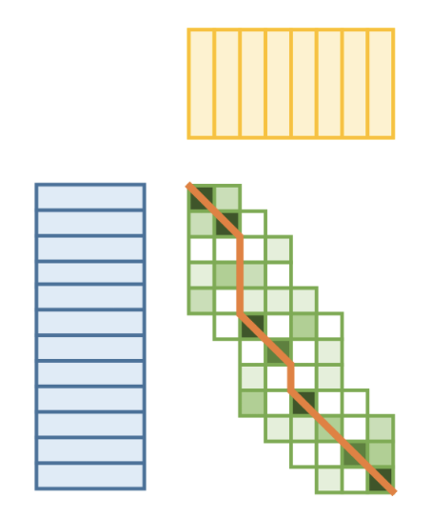
Handling document-level submissions
Sentence segmentation with Stanza (Qi 2020)
Overlaps
Windows of up to 10 sentence, to allow one-to-many alignment
LASER (Artetxe 2019) sentence embeddings
VecAlign (Thompson 2019)
--alignment_max_size 10
--one_to_many
Thompson 2019

Slide 26
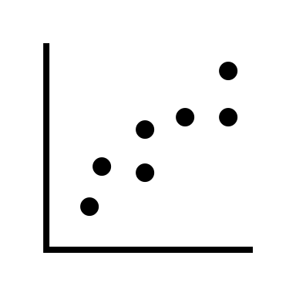
Handling document-level submissions
Reference
Overlap
Embed
Align
Sentence-
segment
System
Assign

Slide 27
Handling document-level submissions
This study aimed to investigate the long-term changes in the relationship between the "Big Five" personality traits (neuroticism, extraversion, openness to experience, agreeableness, and conscientiousness) and several cognitive domains, as well as the interplay between them, from midlife to old age.
We hypothesize that the interplay between the "Big Five" personality traits (Neuroticism, Extraversion, Openness to Experience, Agreeableness and Conscientiousness) and cognitive abilities (information processing speed, crystallized intelligence, fluid intelligence) may change from midlife to old age due to age-associated changes in cognitive and personality plasticity.
The study hypothesized that changes in cognitive abilities would have a greater impact on personality traits in later life.
We used data from the German Interdisciplinary Longitudinal Study of Adult Development (ILSE study; n = 1,002).
The review focuses on hospitalized patients and their potential risks, benefits, and animal programs.
Source
Target

Slide 28
4. Baselines and Team Systems

Slide 29
PLABA_base_1: GPT-3.5, zero-shot, autoregressive
Prompt 1
Prompt 2
Simplify:
Simplify:
Source (abstract)
Source sentence 1
Original:
Source sentence 1
Original:
Source sentence 1
Simple:
Simple:
Completion 1
Source sentence 2
Source sentence 3
Original:
Source sentence 2
Completion 1
Model
Simple:
Completion 2
Model

Slide 30
PLABA_base_2
PLABA_base_3
GPT 3.5
Zero-shot
Document-level
Prompted to rewrite each sentence
Falcon 7B instruct
Zero-shot
Document-level
Simpler prompt

Slide 31

Teams
Team | Location | Institute
BoschAI | Germany | Bosch Center for Artificial Intelligence
Mason_NLP | Virginia, USA | George Mason University
Bee_Manc | United Kingdom | University of Manchester
PTM3 | West Bank/Spain | Palestine Tech. Univ. – Kadoorie; Univ. Carlos III de Madrid

Slide 32
Submissions
Team | Sub. | Description
valeknappich | 1 | “LLama 13B trained with token-based weight losses derived from diffs between source and target. For every sentence, a simplification is generated with varying temperatures. The best simplification is then selected using ChatGPT.”
 | 2 | “LLama 13B trained with token-based weight losses derived from diffs between source and target.”
 | 3 | “Zero-shot prompting of ChatGPT in a sentence-by-sentence fashion.”
Mason_NLP | 1 | “One shot, instruction tuning on GPT-4. Instructions were custom-designed for this task. This had a top preference in our human evaluation.”
 | 2 | “Predictions from a GPT3.5 instruction-tuned model on the training set and had a second preference in our human evaluation.”
 | 3 | “Predictions from the model LLaMa13B-chat fine-tuned on the PLABA training set. This model had 3rd preference in our human evaluation.”
Bee_Man | 1 | “Bart-large with control tokens”
 | 2 | “T5”
 | 3 | “sci-T5”
PTM3 | 1 | “Zero-shot adaptation for biomedical abstracts with biobart model version 2"

Slide 33
5. Manual and Automatic Results

Slide 34
Results Summary
Submission | Auto (SARI) | Manual (0-100) | Strategies
PLABA_base_1 | 35.97 | 92.82 | GPT 3.5 zero-shot w/ autoregressive prompting
PLABA_base_2* | 36.96 | 89.54 | GPT 3.5 zero-shot single prompt
PLABA_base_3* | 23.48 | 44.69 | Falcon7B zero-shot single prompt
MasonNLP_1 | 39.51 | 91.90 | “GPT4 one-shot w/ in-context learning”
BoschAI_1 | 44.65 | 91.87 | “LLama 13B FT w/ token-weighted loss, ChatGPT ranking”
Bee_Manc_1 | 40.59 | 78.87 | “Bart-large with control tokens”
PT3M_1* | 34.55 | 20.40 | “Biobart version 2, zero-shot”
*Automatically aligned document-level system

Slide 35
Manual evaluation
Submission | Simplicity |  |  |  |  | Accuracy | Faith. | Avg. | Avg.
Submission | Sent. | Term. | Term acc. | Fluency | Avg. | Comp. | Faith. | Avg.
PLABA_base_1 | 91.45 | 86.84 | 91.22 | 93.53 | 90.76 | 95.73 | 94.02 | 94.87 | 92.82
PLABA_base_2* | 94.33 | 81.94 | 87.50 | 95.25 | 89.76 | 90.17 | 88.46 | 89.32 | 89.54
PLABA_base_3* | 84.67 | 63.67 | 42.67 | 87.00 | 69.50 | 20.94 | 18.80 | 19.87 | 44.69
MasonNLP_1 | 91.63 | 91.74 | 88.26 | 93.49 | 91.28 | 94.44 | 90.60 | 92.52 | 91.90
BoschAI_1 | 91.11 | 77.25 | 94.11 | 92.96 | 88.86 | 95.30 | 94.44 | 94.87 | 91.87
Bee_Manc_1 | 92.84 | 82.33 | 64.20 | 91.57 | 82.74 | 79.49 | 70.51 | 75.00 | 78.87
PT3M_1* | 38.19 | 34.38 | 21.99 | 18.17 | 28.18 | 16.24 | 8.97 | 12.61 | 20.40
*Automatically aligned document-level system

Slide 36
PLABA_base_1 (GPT-3.5 zero-shot autoregressive)
Source (PMID: 32956694) | PLABA_base_1
Objective: To assess the effect on hemostasis parameters of a new combined oral contraceptive (COC). | Goal: To determine how a new birth control pill affects blood clotting.
Study design: In this randomized, single centre, open-label, exploratory study, healthy women received either 15 mg estetrol/3 mg drospirenone (E4/DRSP) (n = 39), 30 mcg ethinylestradiol/150 mcg levonorgestrel (EE/LNG) (n = 30), or 20 mcg ethinylestradiol/3 mg drospirenone (EE/DRSP) (n = 32) for six 28-day cycles. | Study Design: In this study, healthy women were randomly assigned to receive either a new birth control pill containing 15 mg estetrol and 3 mg drospirenone, a commonly used birth control pill containing 30 mcg ethinylestradiol and 150 mcg levonorgestrel, or another commonly used birth control pill containing 20 mcg ethinylestradiol and 3 mg drospirenone. They took the pills for six cycles, each lasting 28 days.
Blood was collected at baseline, cycle 3, and cycle 6. | Blood samples were collected at the beginning of the study and at the third and sixth cycles.
Median change from baseline was evaluated for procoagulant, anticoagulant, and fibrinolytic parameters, and for sex hormone-binding globulin (SHBG). | We looked at the average changes in blood clotting, blood thinning, and blood clot breakdown, as well as the levels of sex hormone-binding globulin, compared to the beginning of the study.
…

Slide 37
PLABA_base_1 (GPT-3.5 zero-shot autoregressive)
…
Results: Median change of endogenous thrombin potential (ETP) based activated protein C sensitivity resistance (APCr) at cycle 6 was +30% for E4/DRSP, +165% for EE/LNG (p-value <0.05 vs E4/DRSP), and +219% for EE/DRSP (p-value <0.05 vs E4/DRSP). | Results: At the end of the study, the average increase in blood clotting was 30% for women taking the new birth control pill, 165% for women taking the commonly used birth control pill, and 219% for women taking another commonly used birth control pill. These increases were statistically significant compared to the new birth control pill.
Changes to prothrombin fragment 1 + 2 and SHBG for E4/DRSP, EE/LNG, and EE/DRSP were +23%, +71%, and +64% (p-value <0.05 vs E4/DRSP); and +55%, +74% and +251% (p-value <0.05 vs E4/DRSP), respectively. | Changes in blood clotting markers and sex hormone-binding globulin levels were observed in women taking the different birth control pills. These changes varied depending on the type of pill, with some pills causing larger increases in blood clotting and sex hormone-binding globulin compared to others.
At cycle 6, changes to other hemostasis parameters for E4/DRSP were similar or smaller than for EE/LNG or EE/DRSP. | By the sixth cycle of the study, the changes in other blood clotting parameters were similar or smaller in women taking the new birth control pill compared to the other commonly used birth control pills.
…

Slide 38
PLABA_base_1 (GPT-3.5 zero-shot autoregressive)
…
Conclusions: In this study, changes in hemostasis parameters after treatment with 6 cycles of E4/DRSP were smaller or similar to those observed for EE/LNG. | Conclusions: This study found that the new birth control pill had similar or smaller effects on blood clotting compared to the commonly used birth control pill.
Similar, but more pronounced changes were also observed versus EE/DRSP, which supports the hypothesis that the effect of COCs on hemostasis parameters is mainly mediated by the estrogenic component. | Similar, but stronger changes were also seen compared to the other commonly used birth control pill, which suggests that the estrogen in birth control pills is the main factor affecting blood clotting.
Further studies are needed to provide more insight into the venous thromboembolic risk of E4/DRSP. | More studies are needed to understand the risk of blood clots with the new birth control pill.
Implications statement: This study reports that the effects on hemostasis parameters of a COC containing 15 mg E4/3 mg DRSP are less or similar to those for EE/LNG or EE/DRSP. | Implications: This study found that the new birth control pill has similar or smaller effects on blood clotting compared to other commonly used birth control pills.
It also demonstrates that the choice of estrogen modulates the effects of COCs on hemostasis parameters. | It also shows that the type of estrogen in birth control pills affects how they affect blood clotting.

Slide 39
PLABA_base_1 hallucination and inaccuracy
Source (PMID: 25864273) | PLABA_base_1
Materials and methods: The study involved 308 postpartum women who had a medical examination one month after delivery. | For this study, researchers looked at 308 women who had given birth and had a medical check-up one month later. Original: Results: Neck and shoulder pain was experienced by 61.4% of the women, with the highest severity in the neck area. The pain had a negative impact on the women's quality of life. Factors such as age, history of NSP, and work-related factors were found to be associated with NSP. Simple: The study found […]
Source (PMID: 25864273) | PLABA_base_1
The disturbance of daily life due to NSP in postpartum women with past history of PMS and Hiesho were significant higher than that for women without those. | Postpartum women who had a history of premenstrual syndrome (PMS) and anemia during pregnancy experienced more disruption in their daily lives due to neck and shoulder pain compared to women without these conditions.

Slide 40
PLABA_base_3 (Falcon 7B zero-shot document-level)
Source (PMID: 31768813) | Falcon 7B Instruct (zero-shot)
Purpose: To determine predictors of best-corrected postoperative visual acuity (VA) in patients who underwent surgical intervention for macula-off rhegmatogenous retinal detachment. | Purpose: We report an analysis of the visual acuity in a cohort of 100 consecutive eyes that underwent surgical intervention for macula-off rhegmatogenous retinal detachment in a 4-year period.
Materials and methods: Primary macula-off retinal detachments from the University of Colorado Primary Rhegmatogenous Retinal Detachment Database (2012-2017) were reviewed. | A total of 2-year visual outcomes and postoperative predictors for visual recovery were analyzed to identify the factors that may predict visual outcome.
…
Chi-square or Fisher's exact test was used to compare categorical variables, and Wilcoxon rank sum test was used for continuous variables. | Results: A total of 100 eyes underwent surgical intervention for macula-off rhegmatogenous retinal detachment.
…

Slide 41
6. Assessing Automatic Metrics

Slide 42
Manual evaluations vs. SARI

Slide 43
Manual evaluations vs. SARI (huggingface)

Slide 44
Manual evaluations vs. BLEU

Slide 45
Manual evaluations vs. ROUGE-1

Slide 46
Manual evaluations vs. ROUGE-2

Slide 47
Manual evaluations vs. ROUGE-L

Slide 48
Manual evaluations vs. SAMSA

Slide 49
Manual evaluations vs. BERTScore

Slide 50
Summary of manual vs. automatic correlations

Slide 51
7. New Subtask: Term Replacement

Slide 52
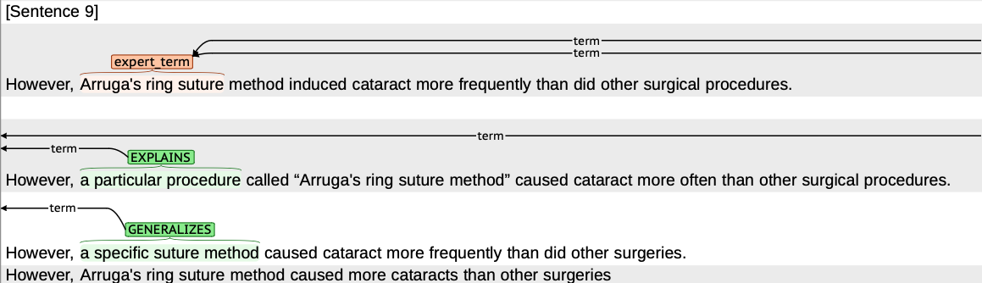
PLABA 2024 @ TREC
New subtask: expert term replacement
Identify
Classify
Generate
{substitute, explain, generalize, exemplify, omit}

Slide 53



Acknowledgements
References
Attal, K., Ondov, B. and Demner-Fushman, D., 2023. A dataset for plain language adaptation of biomedical abstracts. Scientific Data, 10(1), p.8.
Berkman, N.D., Sheridan, S.L., Donahue, K.E., Halpern, D.J. and Crotty, K., 2011. Low health literacy and health outcomes: an updated systematic review. Annals of internal medicine, 155(2), pp.97-107.
Artetxe, M. and Schwenk, H., 2019. Massively Multilingual Sentence Embeddings for Zero-Shot Cross-Lingual Transfer and Beyond. Transactions of the Association for Computational Linguistics, 7, pp.597-610.
Ondov, B., Attal, K. and Demner-Fushman, D., 2022. A survey of automated methods for biomedical text simplification. Journal of the American Medical Informatics Association, 29(11), pp.1976-1988.
Qi, P., Zhang, Y., Zhang, Y., Bolton, J. and Manning, C.D., 2020, July. Stanza: A Python Natural Language Processing Toolkit for Many Human Languages. In Proceedings of the 58th Annual Meeting of the Association for Computational Linguistics: System Demonstrations (pp. 101-108).
Thompson, B. and Koehn, P., 2019, November. Vecalign: Improved sentence alignment in linear time and space. In Proceedings of the 2019 conference on empirical methods in natural language processing and the 9th international joint conference on natural language processing (EMNLP-IJCNLP), pp.1342-1348.
White, R.W. and Horvitz, E., 2009. Cyberchondria: studies of the escalation of medical concerns in web search. ACM Transactions on Information Systems (TOIS), 27(4), pp.1-37.
Dina Demner-
Fushman
Kush Attal
This research was supported by the Intramural Research Program of the National Library of Medicine (NLM), National Institutes of Health.

